Slide 1

Introduction Frontiers in AI and Data Science
Module 6CM521: Frontiers in AI and Data Science
Christos Tsallis, PhD Candidate
University of West Attica, Department of Electrical and Electronics Engineering
Slides acknowledgements:
Dr Hong Qing Yu

Slide 2
About this lecture
EXPLAINED
Lecture 1 of 6CM521
An introduction to data mining and artificial intelligence (AI): definitions, how the fields relate, the history of AI, its main branches, and the Turing test.
How to read these slides
Each original lecture slide is followed by one or more slides marked EXPLAINED.
Explanation slides describe what each image, table, figure and link shows, and why it is used.
Citations in the form (Author, year) refer to the reference list at the end of the deck.
Boxes labelled REFLECT or ACTIVITY are prompts you can work through on your own.
QUESTION slides check your understanding; the model answer follows on the ANSWER slide.
Image on the title slide: a stylised robot head with a gear, a decorative symbol of intelligent machines (AI) built through engineering.

Slide 3


Instructor Contact & Resources
Christos Tsallis
c.tsallis@mc-class.gr
github.com/invariantum

Slide 4
Resources and tools
EXPLAINED
GitHub
Python examples for every practical session of the module.
Start your own repositories: GitHub is your technical portfolio. Employers look at it, not just your CV.
Google Colab & Kaggle
Free notebooks in the browser, with free GPUs.
Nothing to install. We use them for practicals and homework.
Contacting the lecturer
Email with “6CM521” in the subject line so your message is easy to find.
Use the discussion board for questions others may share.

Slide 5
Outlook 1
Core textbooks
Module introduction

Slide 6
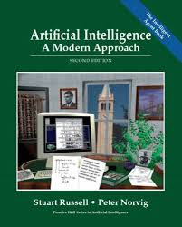

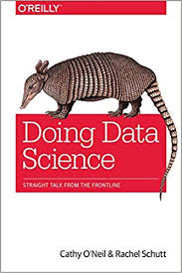

Core textbooks

Slide 7
How to use the textbooks
EXPLAINED
Data Mining: Concepts and Techniques Han, Kamber & Pei
Use it for: Pre-processing, frequent patterns, classification, clustering (Weeks 2-8).
3rd ed. (2011) or 4th ed. (2022)
Artificial Intelligence: A Modern Approach Russell & Norvig
Use it for: Definitions of AI, search, reasoning, knowledge representation. The most widely used AI textbook.
Current: 4th ed. (2020)
Doing Data Science (O’Reilly) O’Neil & Schutt
Use it for: The real-world data science workflow, and the ethics of data. Based on a Columbia University course.
Practical and readable
HOW TO READ Don’t read cover to cover. Read the chapter that matches each week: the lecture is the map, the book gives the detail.
Images on the previous slide: the covers of the three books, and a screenshot of the module’s Online Reading List, where they are linked.

Slide 8
Module topics (Teaching Weeks)
Weeks | Theory | Practical
1 | AI history, branches, application scenarios and relations to Data Mining and Machine Learning | Python basics
2 | Data Pre-processing and EDA | Python - Data Pre-processing
3 | Mining Frequent Pattern and Association Rules | Python - EDA
4 | Classification and Decision Tree | Python - ARL
5 | Random Forest and KNN | Python - DT
7 | Linear Regression & Logistic Regression | Python - KNN
8 | Cluster Analysis with Unsupervised Learning | Python - LR
9 | Artificial Neural Network & Deep Learning | Python - K-Means
10 | Natural Language Processing (NLP) | Python - ANN and DL
11 | Reinforcement Learning & Naïve Bayes | Python - NLP
12 | Knowledge presentation and reasoning | Python - RL and NB
13 | Review
14 -15 | Assessment period
16-18 | Enrichment period: Offsite Activities (Career support, CV support) and assessment feedback
A1 Deadline
Week 14
A2 Deadline

Slide 9
Reading the module table
EXPLAINED
How to read the table
Each row is a teaching week. “Theory” is the lecture topic; “Practical” is the Python lab for that week.
The blue arrows on the right mark the deadlines of Assessment 1 (A1) and Assessment 2 (A2, Week 14).
The red row (Weeks 16-18) is the enrichment period: careers and CV support, and feedback on assessments.
Abbreviations used in the table
EDA | Exploratory data analysis | LR | Linear / logistic regression
ARL | Association rule learning | K-Means | A clustering algorithm
DT | Decision tree | ANN / DL | Artificial neural network / deep learning
Random FR | Random forest | NLP | Natural language processing
KNN | k-nearest neighbours | RL / NB | Reinforcement learning / Naive Bayes
The original table lists Week 6 nowhere; check the module page for its purpose (for example, an independent study week).

Slide 10
How the module is built
EXPLAINED
Theory first, then practice: the practical runs one week behind
Week 2: EDA theory
Week 3: EDA in Python
Week 4: Decision trees
Week 5: Build a tree in Python
The arc of the module
Wk 1
Foundations of AI & data mining
Wk 2-3
Preparing & exploring data; patterns
Wk 4-7
Supervised learning
Wk 8
Unsupervised learning
Wk 9-11
Frontier: deep learning, NLP, RL
Wk 12-13
Reasoning & review
The plan appears again near the end of the lecture, linked to the history and branches of AI.

Slide 11
Learning outcomes
MLO1: Explain fundamental concepts in ML/ AI
MLO2: Apply data mining tools to a problem instance and interpret the results
MLO3: Select and justify choice of AI or ML approach for a specific problem instance

Slide 12
What the outcomes ask of you
EXPLAINED
MLO1
EXPLAIN
MLO2
APPLY + INTERPRET
MLO3
SELECT + JUSTIFY
What a method does
Why it works
When it fails
Running the code is the easy half
Interpreting results is where marks are lost: is the pattern real?
Choose the approach for a real problem
e.g. interpretable model vs black box
Defend your choice
Understand
Apply
Evaluate & choose
The outcomes build on each other, and so does the module.

Slide 13
Check your understanding
QUESTION
UNDERSTANDING
Question 1 of 15
Why does the Python practical run one week behind the lecture topic?
BEFORE YOU MOVE ON Write or say your answer first. The model answer is on the next slide.

Slide 14
Check your understanding: answer
ANSWER
Q1 (Understanding): Why does the Python practical run one week behind the lecture topic?
Model answer
So that each method is first understood in theory and then implemented. For example, exploratory data analysis (EDA) is taught in Week 2 and practised in Python in Week 3.
SEE Slides: How the module is built

Slide 15
Check your understanding
QUESTION
RECALL
Question 2 of 15
What do the three module learning outcomes (MLO1-MLO3) ask you to do?
BEFORE YOU MOVE ON Write or say your answer first. The model answer is on the next slide.

Slide 16
Check your understanding: answer
ANSWER
Q2 (Recall): What do the three module learning outcomes (MLO1-MLO3) ask you to do?
Model answer
MLO1: explain fundamental concepts in ML and AI. MLO2: apply data mining tools to a problem and interpret the results. MLO3: select and justify an AI or ML approach for a specific problem. Together they move from understanding, to applying, to evaluating and choosing.
SEE Slides: Learning outcomes; What the outcomes ask of you

Slide 17
Outlook 2
The definition of Data Mining
The definition of AI and relations to Data Mining
A bit of history of AI and branches
Different levels of machine intelligence (a demo)
Turing test demo for fun
Self-Reading Homework

Slide 18

Data Mining

Slide 19
Section overview: data mining
EXPLAINED
The icon combines a database (the stacked cylinder), a pickaxe and a map: data are “mined” to uncover structure that can be read like a map.
This section covers
What data mining is, and what it aims to achieve
Where data mining fits in the knowledge discovery (KDD) process
A worked example: learning a decision tree from a small customer table
NOTE The name is a metaphor: we mine data for knowledge, not for data. Hence the term “knowledge discovery”.

Slide 20
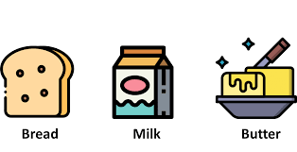

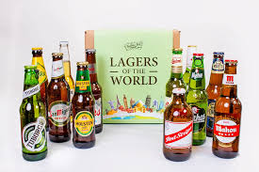
What is Data Mining?
Data mining is a process to turn raw data into useful information and knowledge by using software and algorithms to look for patterns in large batches of data.
For example: businesses can learn more about their customers to develop more effective marketing strategies, increase sales and decrease costs.

Slide 21
The images: market baskets
EXPLAINED
Bread, milk and butter icons • a pack of nappies • a case of beers
Why these images? Market basket analysis
Supermarkets analyse millions of till receipts to find products that are bought together.
Bread, milk and butter illustrate an obvious pattern, written as an association rule: {bread, milk} ⇒ {butter}
Nappies and beer refer to a famous retail story: an analysis supposedly found young fathers buying both in the evening. The story is partly legend, but it shows how data mining can reveal patterns nobody looked for.
LATER IN THE MODULE Frequent patterns and association rules are the topic of Week 3; Python practice follows in Week 4.

Slide 22
Unpacking the definition
EXPLAINED
Raw data → knowledge
Data alone is a cost (storage, security). Value appears when it supports a decision.
Patterns
Items that occur together, groups of similar cases, rules that predict an outcome.
Large batches
Far too much for any human to inspect, so we need algorithms.
Typical applications
Retail: market basket analysis for store layout, promotions and stock planning
Banking: detecting unusual, possibly fraudulent, transactions
Healthcare, streaming, manufacturing: diagnosis support, recommendations, predictive maintenance
REFLECT Which apps or services that you use every day rely on finding patterns in data?

Slide 23
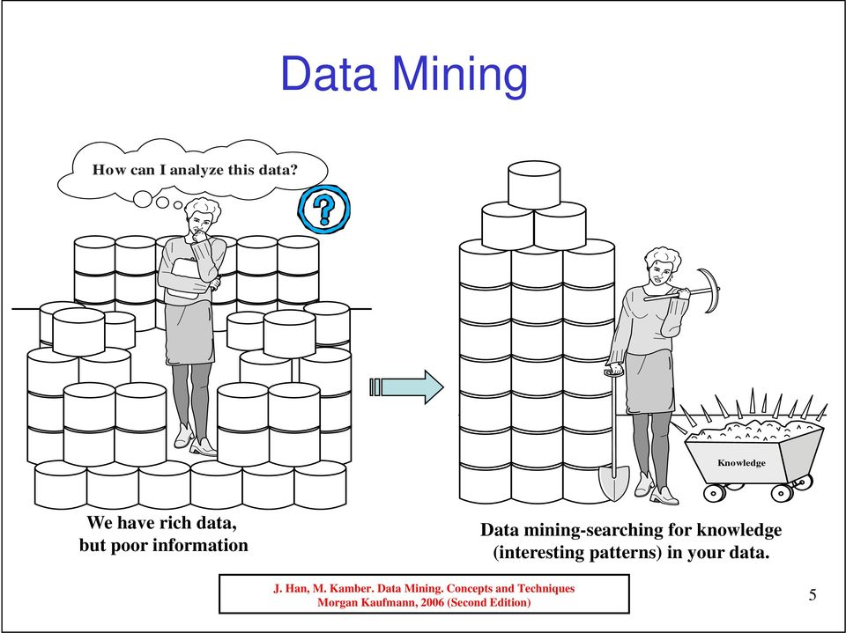
Aim of Data Mining

Slide 24
The figure: rich data, poor information
EXPLAINED
Reading the cartoon
Left: a person surrounded by stacks of data asks “How can I analyse this data?”
Right: after mining, the data yield a small cart labelled “knowledge”.
The arrow between them is the data mining process.
The message
“We have rich data, but poor information.” Organisations collect far more data than they analyse; data mining searches for the interesting patterns that turn data into knowledge.
NOTE Only a small amount of knowledge comes out of a large amount of data, as the cart shows.
Figure source: Han and Kamber (2006), Data Mining: Concepts and Techniques, 2nd edn (citation printed on the image).

Slide 25
What makes a pattern interesting?
EXPLAINED
DATA RICH, INFORMATION POOR Banks, hospitals and phone operators collect data every second; most of it is never analysed.
An interesting pattern is…
Valid
It still holds on new data.
Novel
It is not already known.
Useful
It can support an action or decision.
Understandable
People can interpret it.
EXAMPLE “Buyers of a left shoe also buy a right shoe” is true, but not interesting.
Source: criteria from Fayyad, Piatetsky-Shapiro and Smyth (1996); Han and Kamber (2006).

Slide 26
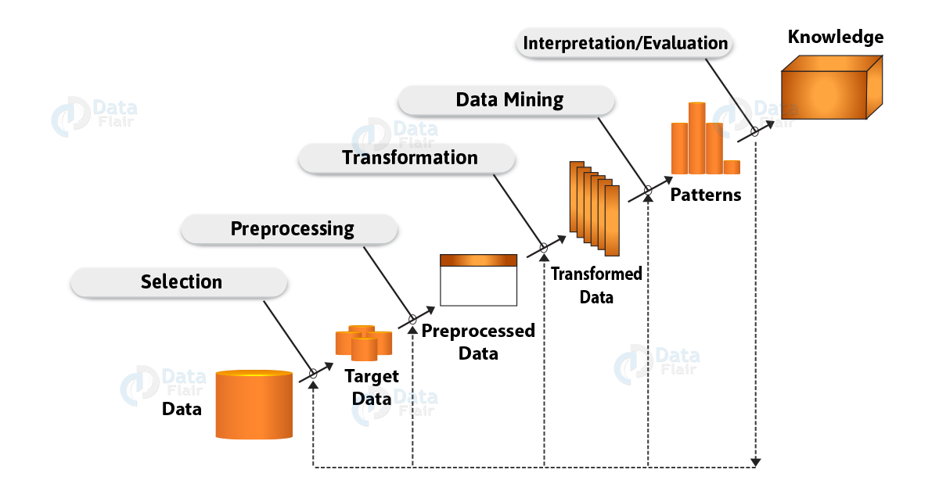
An important step of knowledge discovery

Slide 27
The figure: the KDD process
EXPLAINED
Reading the figure
Read it as a staircase from bottom left (raw data) to top right (knowledge).
Each labelled step (selection, preprocessing, transformation, data mining, interpretation/evaluation) produces a new version of the data: target data, preprocessed data, transformed data, patterns.
The dotted lines along the bottom show that you can return to any earlier step: the process is iterative.
The red circle on the original slide highlights the goal of the whole process: knowledge.
Figure source: DataFlair illustration of the KDD process described by Fayyad, Piatetsky-Shapiro and Smyth (1996).

Slide 28
The five steps of KDD
EXPLAINED
1
Selection
Choose the relevant data, e.g. for customer churn: billing and complaints, not network logs.
60-80%
of a data scientist’s time is often spent on steps 1-3
2
Pre-processing
Fix missing values, duplicates, typos, outliers, formats (Week 2).
3
Transformation
Normalise, encode categories, create features, reduce dimensions.
Garbage in, garbage out
Bad data gives bad models.
4
Data mining
Apply the algorithm: classification, clustering, association rules.
Iterative
Poor results? Go back a step.
5
Interpretation
Are the patterns valid and useful? Turn them into actionable knowledge.
In industry: CRISP-DM
Same logic, different names.
Sources: Fayyad, Piatetsky-Shapiro and Smyth (1996).

Slide 29
Check your understanding
QUESTION
RECALL
Question 3 of 15
What are the five steps of the KDD process, and which one is data mining?
BEFORE YOU MOVE ON Write or say your answer first. The model answer is on the next slide.

Slide 30
Check your understanding: answer
ANSWER
Q3 (Recall): What are the five steps of the KDD process, and which one is data mining?
Model answer
Selection, pre-processing, transformation, data mining, and interpretation/evaluation. Data mining is only step 4: most of the effort usually goes into steps 1-3, and the process is iterative.
SEE Slides: The figure: the KDD process; The five steps of KDD

Slide 31
Check your understanding
QUESTION
UNDERSTANDING
Question 4 of 15
Is “buyers of a left shoe also buy a right shoe” an interesting pattern? Use the four criteria.
BEFORE YOU MOVE ON Write or say your answer first. The model answer is on the next slide.

Slide 32
Check your understanding: answer
ANSWER
Q4 (Understanding): Is “buyers of a left shoe also buy a right shoe” an interesting pattern? Use the four criteria.
Model answer
No. It is valid, but it is not novel (everyone already knows it) and not useful (it supports no new decision). An interesting pattern must be valid, novel, useful and understandable.
SEE Slides: What makes a pattern interesting?

Slide 33
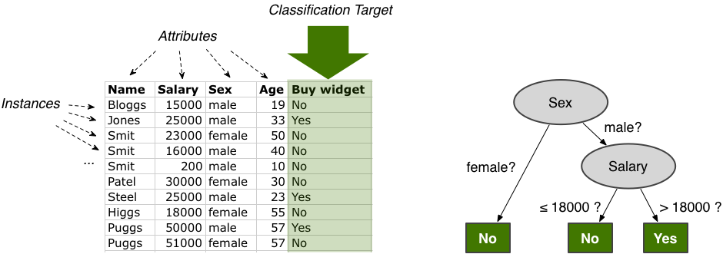
Data Mining example

Slide 34
The figure: table and tree
EXPLAINED
The table
Instances (rows): 10 customers
Attributes (columns): name, salary, sex, age
Classification target (green column, arrow): “Buy widget”, Yes or No
Task: predict the target from the attributes
The decision tree
Start at the top node and answer each question.
Female → No.
Male → check salary: ≤ 18,000 → No; > 18,000 → Yes.
Check: Jones (male, 25,000) → Yes, which matches the table.
Figure: illustrative example data and the decision tree learned from them (image adapted from a web tutorial).

Slide 35
Would you trust this rule?
EXPLAINED
Learned rule: IF male AND salary > 18,000 → buys the widget
It fits all 10 customers. “Age” is never used; “name” is only an identifier.
REFLECT Would you trust this rule? Would you base a marketing campaign on it?
Overfitting
Only 10 customers. A perfect fit says little about the next thousand.
Correlation ≠ causation
The rule does not explain why anyone buys.
Fairness
Rules based on sex can be discriminatory and unlawful, e.g. for loans (EU law).
KEY POINT One tiny example, three big themes: generalisation, causality, fairness. We build decision trees in Python in Week 5.
Example data: illustrative only.

Slide 36
Check your understanding
QUESTION
UNDERSTANDING
Question 5 of 15
Why is a decision tree that fits all 10 customers perfectly not convincing?
BEFORE YOU MOVE ON Write or say your answer first. The model answer is on the next slide.

Slide 37
Check your understanding: answer
ANSWER
Q5 (Understanding): Why is a decision tree that fits all 10 customers perfectly not convincing?
Model answer
Ten cases are far too few: a perfect fit may simply memorise them (overfitting) and fail on new customers. The rule also shows correlation, not causation, and a rule based on sex raises fairness concerns.
SEE Slides: Would you trust this rule?

Slide 38

Artificial Intelligence (AI)

Slide 39
Section overview: AI
EXPLAINED
The illustration shows a laptop wearing a graduation cap, connected to books, a light bulb and other ideas. It suggests a machine that learns and reasons, which is the theme of AI.
This section covers
How leading textbooks define artificial intelligence
The four approaches to AI (Russell and Norvig)
How data mining, machine learning and AI relate to each other
NOTE Data mining gives patterns; AI asks how machines can use knowledge to act intelligently.

Slide 40
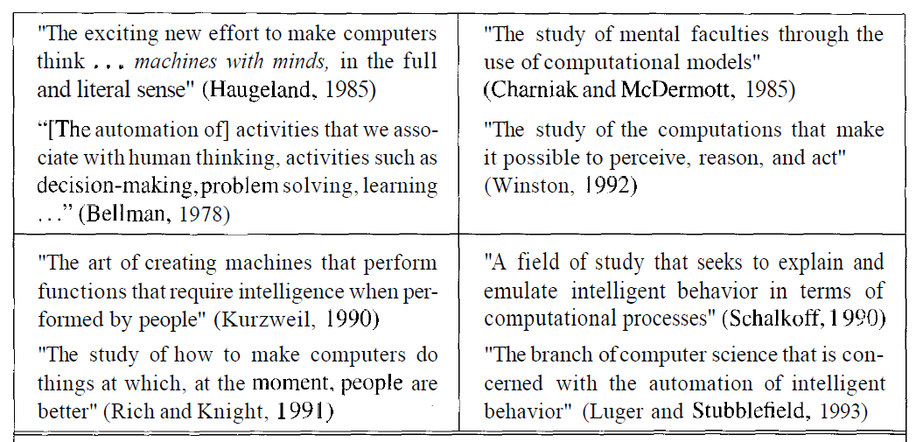
What is AI?
Artificial Intelligence, A Modern Approach. Second Edition
Systems that think like humans | Systems that think rationally
Systems that act like humans | Systems that act rationally

Slide 41
The figure: eight definitions
EXPLAINED
The eight definitions, grouped as in the table below them on the original slide
Think like humans
Haugeland (1985): machines with minds
Bellman (1978): automating human-like thinking
Think rationally
Charniak and McDermott (1985): mental faculties as computation
Winston (1992): computations to perceive, reason, act
Act like humans
Kurzweil (1990): machines doing what needs intelligence in people
Rich and Knight (1991): doing what people currently do better
Act rationally
Schalkoff (1990): emulating intelligent behaviour computationally
Luger and Stubblefield (1993): automating intelligent behaviour
Figure source: Russell and Norvig (2003), Artificial Intelligence: A Modern Approach, 2nd edn, Figure 1.1. The colours on the original slide mark the four quadrants.

Slide 42
Four approaches to AI
EXPLAINED
HUMAN
RATIONAL
THINKING
Think like humans
Cognitive modelling: needs psychology and neuroscience (cognitive science).
Think rationally
“Laws of thought”: Aristotle and formal logic.
ACTING
Act like humans
The Turing test: behaviour indistinguishable from a human.
Act rationally
The rational agent: acts for the best expected outcome. The dominant view today.
REFLECT Which quadrant fits a self-driving car? Usually “act rationally”: we want optimal, safe driving, not human-like driving. Where would you place ChatGPT?
Source: Russell and Norvig (2003; 2020).

Slide 43
Check your understanding
QUESTION
APPLICATION
Question 6 of 15
Which of the four approaches to AI fits a self-driving car, and why?
BEFORE YOU MOVE ON Write or say your answer first. The model answer is on the next slide.

Slide 44
Check your understanding: answer
ANSWER
Q6 (Application): Which of the four approaches to AI fits a self-driving car, and why?
Model answer
Acting rationally. We want the car to choose the best and safest action in each situation, not to imitate how an average human drives, mistakes included.
SEE Slides: Four approaches to AI

Slide 45
Modern or Your Definition
“AI refers to the simulation of human intelligence in machines that are programmed to think like humans and mimic their actions. The term may also be applied to any machine that exhibits traits associated with a human mind such as learning and problem-solving.”
Investopedia
AI refers to a soft or hard device that can make inferences and best decisions to support next action or provide recommendations through collected digital information and humankind learning process.
- Dr Hong Qing Yu (working definition)

Slide 46
Comparing the definitions
EXPLAINED
Investopedia
Human-centred
“Simulation of human intelligence”
“Think like humans and mimic their actions”
→ the human column of Russell & Norvig
Working definition (Dr Hong Qing Yu)
Rational and data-driven
“Soft or hard device”: software or robot
“Best decisions”: a rational agent
“Collected digital information”: the link to data mining
ACTIVITY Write your own one-sentence definition (“For me, AI is …”) and place it in one of the four quadrants.
There is no single agreed definition: AI sits between computer science, maths, psychology, philosophy and engineering.
Sources: Investopedia (n.d.); working definition by Dr Hong Qing Yu (original lecture slides).

Slide 47

The title of the module
Frontiers in AI and Data Science (good name!), but you may feel a bit of confusion.
Actually, data mining partially belongs to AI field
How about MACHINE LEARNING then?

Slide 48
The image: why the confusion?
EXPLAINED
Why this image?
Two puzzled people with question marks represent a common confusion: the terms data mining, machine learning and AI overlap, and are often used as if they meant the same thing.
The point of the slide
A module that combines AI and data science covers related, overlapping fields.
Data mining partly belongs to AI: some of its methods come from AI, others from statistics and databases.
The next slides define machine learning and show how the fields overlap.

Slide 49
Data mining, ML and AI
EXPLAINED
Artificial intelligence: The broad goal: systems that perceive, reason, decide and act. Machine learning is its most successful approach today.
Machine learning: The algorithms that learn from data.
Data mining: The process of finding knowledge in data. It uses ML, statistics and databases as tools.
Two classic definitions of machine learning
Arthur Samuel (1959)
“The ability to learn without being explicitly programmed.”
Tom Mitchell (1997)
A program learns from experience E, for task T and performance measure P, if its performance on T, measured by P, improves with E.
Sources: Samuel (1959); Mitchell (1997).

Slide 50
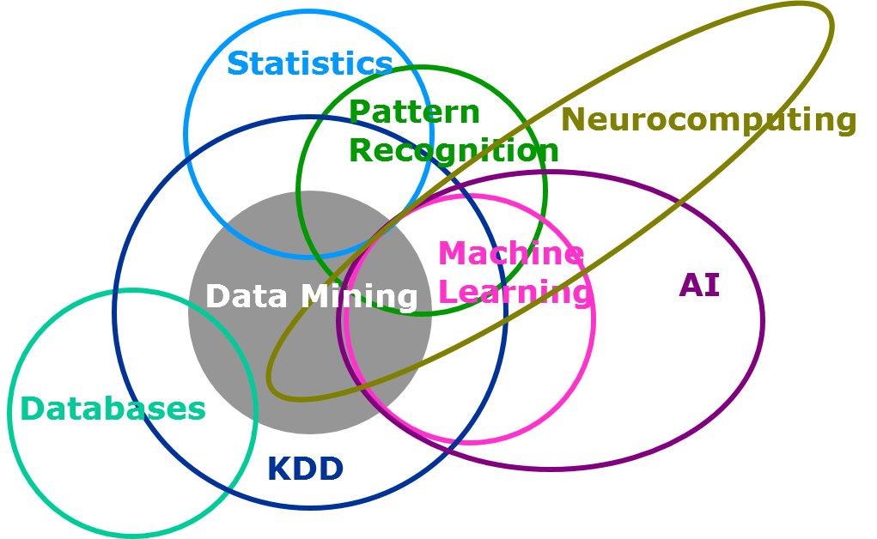
Relations between Data Mining, Machine Learning, AI and others

Slide 51
Reading the diagram
EXPLAINED
Statistics | The mathematical foundation: probability, testing, regression
Databases | Storing, managing and querying data efficiently
Machine learning | The learning algorithms; mostly inside AI
Pattern recognition | Between statistics and ML, e.g. faces, handwriting
Neurocomputing | Brain-inspired computing: neural networks → deep learning
KDD | The whole discovery process; contains data mining
TAKEAWAY Data mining is interdisciplinary: you need statistics, databases, ML and AI. Drawn today, one more circle would surround it all: Data Science, plus domain knowledge.
Figure on the previous slide: a Venn diagram of data mining and neighbouring fields, widely used in data mining teaching (often attributed to SAS Institute).

Slide 52
Check your understanding
QUESTION
UNDERSTANDING
Question 7 of 15
How are data mining, machine learning and AI related?
BEFORE YOU MOVE ON Write or say your answer first. The model answer is on the next slide.

Slide 53
Check your understanding: answer
ANSWER
Q7 (Understanding): How are data mining, machine learning and AI related?
Model answer
AI is the broad goal of building intelligent systems; machine learning is the set of algorithms that learn from data and is AI’s most successful approach today; data mining is the process of finding knowledge in data, using ML together with statistics and databases. The fields overlap rather than nest neatly.
SEE Slides: Data mining, ML and AI; Reading the diagram

Slide 54
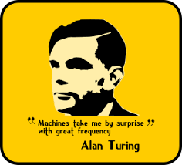
A bit of History of AI

Slide 55
Section overview: history
EXPLAINED
Image: a stylised portrait of Alan Turing with his words “Machines take me by surprise with great frequency” (Turing, 1950). He wrote this in reply to the objection that machines can never do anything new.
This section: a timeline of AI
1950
Turing asks “Can machines think?”
1956
Dartmouth: AI is born
1956-74
Golden years
1974-80
First AI winter
1980-87
Expert systems boom
1987-93
Second AI winter
1990s
Learning and probability
2010s-
Deep learning boom
Orange boxes mark the two “AI winters”: periods of reduced funding and interest.

Slide 56
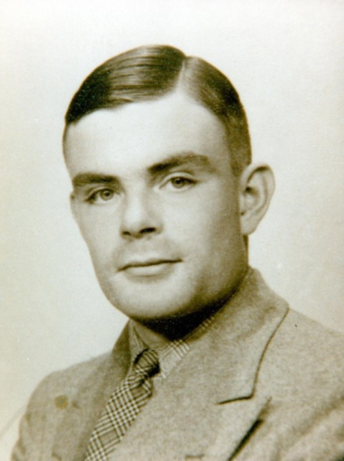
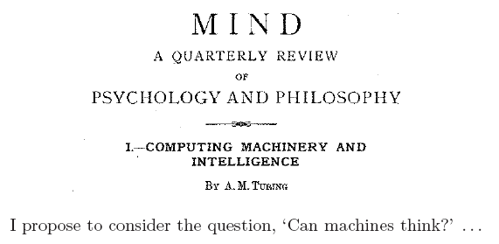
A bit of history of AI (start)
Long long ago…
Philosopher Aristotle (384-322 B.C.)
My story will start from 1950 in the UK and one important publication:
  Turing, A.M. (1950), Computing machinery and intelligence, Mind, Vol. 59, pp. 433-460.

Slide 57
The images: Mind and Turing
EXPLAINED
Left: the 1950 article
Title page of “Computing Machinery and Intelligence” in Mind, a quarterly review of psychology and philosophy.
The red box highlights its opening question: “Can machines think?”
Publishing in a philosophy journal shows that AI began as a philosophical question as well as a technical one.
Right: Alan Turing
Alan Turing (1912-1954), British mathematician and a founder of computer science.
Source: Turing (1950). Aristotle (384-322 BC) appears on the slide as the earliest attempt to formalise reasoning.

Slide 58
From Aristotle to Turing
EXPLAINED
384 BC
1936
1939-45
1950
Aristotle, born in Stagira (northern Greece): the syllogism
Turing machine: the model of every computer
Bletchley Park: breaking the Enigma code
“Computing Machinery and Intelligence”
All men are mortal. Socrates is a man. ∴ Socrates is mortal.
Reasoning as formal rules that can be applied mechanically: the philosophical root of AI
DID YOU KNOW? Computing’s highest honour, the Turing Award (“the Nobel Prize of computing”), is named after Alan Turing.
Sources: Turing (1950).

Slide 59
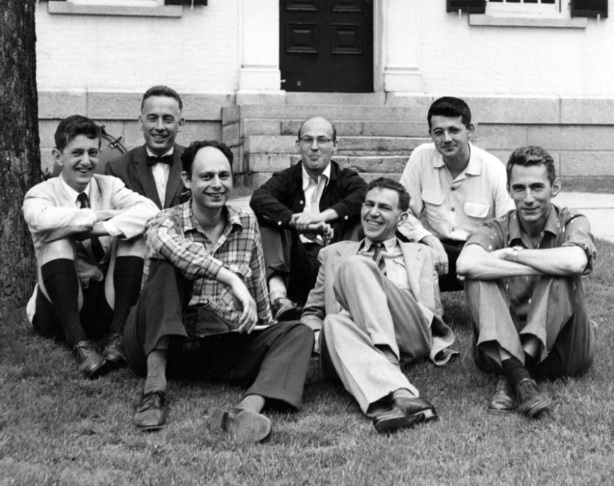
A bit of history of AI (born)
The official birth of artificial intelligence:
  1956: Dartmouth Conference - "Artificial Intelligence" adopted
  The term ‘Artificial Intelligence’ was coined in a proposal for the conference at Dartmouth College in 1956
  1) Dr. Marvin Minsky (MIT co-founder)
  2) Dr. Julian Bigelow (Computing)
  3) Professor D.M. Mackay (Neuro)
  4) Mr. Ray Solomonoff (Probability)
  5) Mr. John Holland (genetic)
  6) Mr. John McCarthy (MIT, lisp)
  7) Dr. Claude Shannon (IT)

Slide 60
The images: Dartmouth 1956
EXPLAINED
The photograph
A group of participants of the 1956 Dartmouth summer workshop, photographed in front of Dartmouth Hall, New Hampshire. It is one of the few photographs of the event that gave AI its name.
The list of names
The underlined names are links to each person’s biography (Wikipedia).
The labels in brackets give each person’s field: neuroscience, probability, genetic algorithms, information theory (IT), and the Lisp language.
The 1955 proposal was written by McCarthy, Minsky, Rochester and Shannon; other researchers attended for parts of the summer.
Sources: McCarthy et al. (1955); photograph of the Dartmouth workshop participants, 1956.

Slide 61
Dartmouth 1956
EXPLAINED
“Every aspect of learning or any other feature of intelligence can in principle be so precisely described that a machine can be made to simulate it.”
Dartmouth proposal, 1955
Written by John McCarthy, Marvin Minsky, Nathaniel Rochester (IBM) and Claude Shannon (Bell Labs). McCarthy coined the term “artificial intelligence”.
Interdisciplinary from birth
Mathematics
Engineering
Neuroscience
Probability
Information theory
Genetic algorithms
FIRST AI PROGRAM Newell & Simon’s Logic Theorist proved 38 of the first 52 theorems of Principia Mathematica.
Sources: McCarthy et al. (1955); Newell and Simon (1956).

Slide 62
Check your understanding
QUESTION
RECALL
Question 8 of 15
Where and when was the term “artificial intelligence” introduced, and by whom?
BEFORE YOU MOVE ON Write or say your answer first. The model answer is on the next slide.

Slide 63
Check your understanding: answer
ANSWER
Q8 (Recall): Where and when was the term “artificial intelligence” introduced, and by whom?
Model answer
In the 1955 proposal for the 1956 Dartmouth summer workshop. John McCarthy coined the term; the proposal was also signed by Minsky, Rochester and Shannon.
SEE Slides: Dartmouth 1956

Slide 64
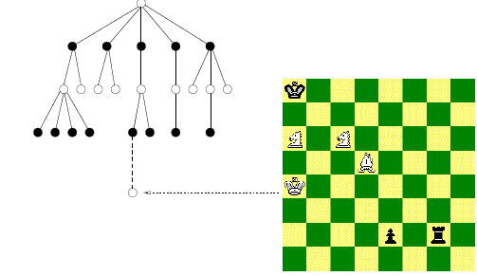
A bit of history of AI (early days)
Two major themes that have driven AI development from the start to today are: Game-play and Robot
One of the early research in AI is search problem such as for game-playing. Game-playing can be usefully viewed as a search problem in a space defined by a fixed set of rules
Nodes are either white or black corresponding to reflect the adversaries’ turns.
The tree of possible moves can be searched for favourable positions.

Slide 65
The figure: a game tree
EXPLAINED
A game tree
Each node is a position in the game.
Branches are the moves available from that position.
Black and white nodes alternate, like the two players’ turns.
Linking the tree to the board
The dotted line connects one node of the tree to the chessboard: every node stands for a complete board position.
Searching the tree means looking ahead: “if I play this, my opponent can reply with that…”.
The program picks the branch that leads to the best position it can guarantee, assuming the opponent also plays well (the minimax idea).
Sources: Shannon (1950); Russell and Norvig (2020), chapter on adversarial search.

Slide 66
Game playing as search
EXPLAINED
How a program plays
Minimax: pick the move that is best assuming the opponent also plays their best.
Alpha-beta pruning: skip branches that cannot change the decision.
~35 legal moves per chess position
2.7 × 10¹⁵ positions only 10 moves (plies) ahead
~10¹²⁰ possible games (Shannon, 1950): more than atoms in the universe
KEY POINT You cannot search everything: you need clever search and good evaluation of positions.
ORIGIN Arthur Samuel’s checkers program (IBM, 1950s) improved by playing itself: the origin of “machine learning”.
Sources: Shannon (1950); Samuel (1959).

Slide 67
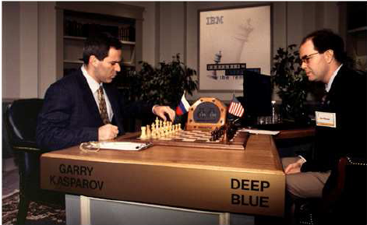
A bit of history of AI (victory)
The real success of AI in game-playing was achieved much later after many years’ effort.
It has been shown that this search based approach works extremely well.
In 1996 IBM Deep Blue won a game against Garry Kasparov but lost the match. In 1997 an upgraded version won an entire match.
https://www.kaggle.com/harryyu/week10-reinforcement-learning-frozenlake-v0

Slide 68
The image and the link
EXPLAINED
The photograph
World chess champion Garry Kasparov (left) playing IBM’s Deep Blue. A member of the IBM team sits opposite and moves the pieces chosen by the computer. The name plates read “Garry Kasparov” and “Deep Blue”.
The link on the slide
It points to a Kaggle notebook on reinforcement learning using the FrozenLake environment.
FrozenLake is a small grid world: an agent must learn by trial and error to cross a frozen lake to a goal without falling through holes.
It previews the next step after search-based game playing: systems that learn from experience, such as AlphaGo. Reinforcement learning is Week 11.
Sources: Campbell, Hoane and Hsu (2002); Silver et al. (2016).

Slide 69
From Deep Blue to AlphaGo
EXPLAINED
Feb 1996
May 1997
Mar 2016
Deep Blue wins one game, but Kasparov wins the match 4-2
Upgraded Deep Blue wins the rematch 3½-2½
AlphaGo beats Go champion Lee Sedol 4-1
Deep Blue: programmed
Brute-force search, ~200 million positions per second
Evaluation hand-crafted with grandmasters
AlphaGo: learned
Tree search + deep neural networks
Reinforcement learning from self-play
THE SHIFT From hand-programmed knowledge to learned knowledge. Reinforcement learning is Week 11.
Sources: Campbell, Hoane and Hsu (2002); Silver et al. (2016).

Slide 70
Check your understanding
QUESTION
UNDERSTANDING
Question 9 of 15
What is the key difference between how Deep Blue (1997) and AlphaGo (2016) played?
BEFORE YOU MOVE ON Write or say your answer first. The model answer is on the next slide.

Slide 71
Check your understanding: answer
ANSWER
Q9 (Understanding): What is the key difference between how Deep Blue (1997) and AlphaGo (2016) played?
Model answer
Deep Blue relied on brute-force search with an evaluation function hand-crafted by experts (programmed knowledge). AlphaGo combined search with deep neural networks trained by reinforcement learning from self-play (learned knowledge).
SEE Slides: From Deep Blue to AlphaGo

Slide 72
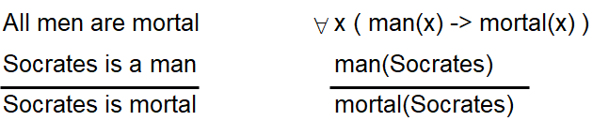
A bit of history of AI (development)
deductive logic (theorem-provers):
Common sense reasoning: the idea was to code common sense knowledge as logical axioms, and employ a theorem-prover (John McCarthy and Patrick Hayes)
  Reasoning as search: Newell and Simon developed a program called the "General Problem Solver".
  Natural language Processing: Ross Quillian proposed the semantic networks and Margaret Masterman & colleagues at Cambridge design semantic networks for machine translation

Slide 73
The figure: logic notation
EXPLAINED
English | First-order logic | Meaning
All men are mortal | ∀x (man(x) → mortal(x)) | For every x: if x is a man, then x is mortal
Socrates is a man | man(Socrates) | A fact about one individual
Socrates is mortal | mortal(Socrates) | The conclusion, written below the line
Symbols
∀ = “for all”; → = “if … then”; the horizontal line separates the premises (above) from the conclusion (below). A theorem prover applies such inference rules automatically to derive new facts.
This syllogism goes back to Aristotle; the logical form is standard first-order logic (Russell and Norvig, 2020).

Slide 74
Four early directions
EXPLAINED
Theorem proving
Write knowledge in logic; the program derives new facts automatically.
→ Week 12
Common-sense reasoning
McCarthy & Hayes: everyday knowledge as axioms. Far harder than expected, and still hard today.
→ Week 12
Reasoning as search
General Problem Solver (~1957): means-ends analysis reduces the gap between current state and goal.
→ search
Natural language
Quillian: semantic networks (“a canary is a bird; a bird can fly”). Masterman, Cambridge: machine translation.
→ Week 10
These directions are the roots of topics later in this module.
Sources: McCarthy and Hayes (1969); Newell, Shaw and Simon (1959); Quillian (1968).

Slide 75
A bit of history of AI
(golden years)
Golden years: 1956-1974
    Lisp: John McCarthy (MIT) invented the Lisp language.
Funding for AI research:
  Significant funding from both USA and UK governments
The optimism:
  1965, Simon: "machines will be capable, within twenty years, of doing any work a man can do"
  1970, Minsky: "In from three to eight years we will have a machine with the general intelligence of an average human being."

Slide 76
The golden years: lessons
EXPLAINED
Lisp (McCarthy, 1958)
The main AI language for decades. Ideas such as garbage collection live on, including in Python.
Predictions vs reality
Simon, 1965
“within twenty years” machines would do any work a man can do
✗ Did not happen
Minsky, 1970
general human-level intelligence “in from three to eight years”
✗ Did not happen
Generous funding
ARPA (now DARPA) funded MIT, Stanford and CMU; the UK funded AI too.
ELIZA (Weizenbaum, 1966)
A pattern-matching “therapist” chatbot. Users became attached, though it understood nothing.
TODAY We hear similar AGI predictions. Take them seriously, but critically.
Sources: Simon (1965); Weizenbaum (1966); Darrach (1970).

Slide 77
A bit of history of AI
(1ST AI winter)
The first AI winter 1974−1980:
  Problems
    Limited computer power: There was not enough memory or processing speed to accomplish anything truly useful
    Intractability and the combinatorial explosion. In 1972 Richard Karp showed there are many problems that can probably only be solved in exponential time (in the size of the inputs), famously named as NP (nondeterministic polynomial time) complete/hard problem.
    Common sense knowledge and reasoning. Many important applications like vision or natural language require simply enormous amounts of information about the world and handling uncertainty.
  The end of funding
    The agencies which funded AI research became frustrated with the lack of progress and eventually cut off most funding for AI research.

Slide 78
Why the first winter came
EXPLAINED
Three problems
Computing power
Quillian’s language demo had a vocabulary of just 20 words: all that fitted in memory.
Combinatorial explosion
Karp (1972): 21 NP-complete problems. No known efficient algorithm; P vs NP is still open.
Common sense & uncertainty
Strict logic could not cope with a messy, uncertain world.
…so the funding stopped
UK: Lighthill Report (1973): highly critical → sharp cuts
US: DARPA frustrated by slow progress (e.g. speech understanding) → cuts
Neural nets: Minsky & Papert, Perceptrons (1969): limits of single-layer networks → a decade of stagnation
Sources: Minsky and Papert (1969); Karp (1972); Lighthill (1973).

Slide 79
A bit of history of AI (Rebranding)
Boom 1980-1987:
  In the 1980s a form of AI program called "expert systems" was adopted (rule-based technologies) by corporations around the world and knowledge representation became the focus of mainstream AI research
    The power of expert systems came from the expert knowledge using rules that are derived from the domain experts
    In 1980, an expert system called XCON was completed for the Digital Equipment Corporation. It was an enormous success: it was saving the company 40 million dollars annually by 1986
    By 1985 the market for AI had reached over a billion dollars
  The money returns: the fifth generation project
  However, the fundamental issue about uncertainty (today we call it probability and fuzzy learning) and capability of dealing with big size data aren’t really solved at all in that time.

Slide 80
How expert systems worked
EXPLAINED
Human expert
Knowledge base
(IF-THEN rules)
Inference engine
Advice / decision
Example rule: IF fever AND infection is bacterial THEN consider antibiotic X
The boom
XCON/R1 (CMU, for DEC) configured VAX computer orders: ~$40M saved per year by 1986
Corporate AI spending passed $1 billion a year by 1985
Japan’s Fifth Generation project (1982); UK Alvey; US Strategic Computing
The weakness
Poor at handling uncertainty
Could not learn from data
Every rule written by hand
KEY POINT The power came from expert knowledge, not from a clever general algorithm.
Sources: McDermott (1982).

Slide 81
A bit of history of AI
(2nd AI winter)
the second AI winter 1987−1993
  In 1987, the Lisp Machine market collapsed, as desktop computers from Apple and IBM had been steadily gaining speed and power and in 1987 they became more powerful than the more expensive Lisp machines made by Symbolics and others
  Eventually the earliest successful expert systems, such as XCON, proved too expensive to maintain, as they were difficult to update and unable to learn.
  In the late 80s and early 90s, funding for AI has been deeply cut due to the limitations of the expert systems and the expectations for Japan's Fifth Generation Project not being met

Slide 82
Why expert systems failed
EXPLAINED
Hardware collapse
Cheaper Apple and IBM desktops overtook expensive Lisp machines (1987).
Costly maintenance
XCON grew to ~10,000 rules: hard to update, unable to learn.
Brittleness
Absurd mistakes just outside the situations their rules covered.
Knowledge bottleneck
Extracting knowledge from experts was slow and expensive.
Broken expectations
Japan’s Fifth Generation project missed its goals → deep cuts.
LESSON Hand-written rules do not scale. The answer: let machines learn from data.
Sources: McDermott (1982); Russell and Norvig (2020, ch. 1).

Slide 83
Check your understanding
QUESTION
UNDERSTANDING
Question 10 of 15
Why did expert systems fail to scale, and what lesson did AI draw from this?
BEFORE YOU MOVE ON Write or say your answer first. The model answer is on the next slide.

Slide 84
Check your understanding: answer
ANSWER
Q10 (Understanding): Why did expert systems fail to scale, and what lesson did AI draw from this?
Model answer
Every rule had to be written by hand: systems such as XCON grew to about 10,000 rules, were costly to update, brittle outside their rules, and could not learn. The lesson was to let machines learn from data instead.
SEE Slides: Why expert systems failed

Slide 85
A bit of history of AI
(late 80s to 90s new ideas)
  In the period of 2nd AI winter (in the late 80s), lots of new ideas are proposed which are the foundations of today’s AI approaches.
  A completely new approach to AI, based on robotics, has been proposed by Brooks in his paper "Elephants Don't Play Chess”, based on the belief that, to show real intelligence, a machine needs to have a body — it needs to perceive, move, survive and deal with the world.
  Artificial Neural Networks (ANN) to learn data features
  Probabilistic and Statistical approach
  Knowledge representation with Fuzzy framework
  Image processing and vision recognition

Slide 86
The ideas behind today’s AI
EXPLAINED
1965
Zadeh: fuzzy sets, i.e. degrees of truth (“fairly warm”) → Sendai subway fuzzy control, 1987
1986
Rumelhart, Hinton & Williams popularise backpropagation for multi-layer neural networks
1988
Judea Pearl: Bayesian networks → probabilistic reasoning (Naive Bayes, Week 11)
1989
LeCun: neural networks read handwritten postcodes → ancestor of deep learning
1990
Brooks, “Elephants Don’t Play Chess”: intelligence needs a body → iRobot, the Roomba
COMMON THREAD From hand-coded knowledge to learning from data and handling uncertainty: the paradigm of this module.
Sources: Zadeh (1965); Rumelhart, Hinton and Williams (1986); Pearl (1988); LeCun et al. (1989); Brooks (1990).

Slide 87

Winter again

Slide 88
The image: an AI winter
EXPLAINED
Why a snowy image?
The photograph of a snow-covered forest path is a visual metaphor for an “AI winter”: a cold period of reduced funding and interest in AI.
Where the term comes from
“AI winter” was coined in 1984, at the annual meeting of the American Association for Artificial Intelligence, by analogy with “nuclear winter”, as a warning that the expert-systems boom could collapse.
WHY “AGAIN”? The slide asks whether, after the two historical winters, a new period of disappointment could follow today’s boom. The next slide sets out both sides.

Slide 89
Could winter come again?
EXPLAINED
After 1993, “AI” stayed unfashionable. Researchers said “machine learning”, “data mining” or “informatics” instead, while AI quietly powered spam filters, search engines and recommenders.
The “AI effect”: once it works, people stop calling it AI.
Signs of cooling
High training and running costs; energy use
Uncertain return on investment
Limits of high-quality training data
“Hallucinations”: confident false answers
Against a winter
Used daily by hundreds of millions of people
Generates real revenue
Built into everyday products
REFLECT Could another AI winter come? Your skill as a professional: separate real capability from promises.
Sources: Russell and Norvig (2020, ch. 1).

Slide 90
Brief history of AI
(booming today)
Main reasons:
Hardware power (GPU, storage)
Cloud computing (Internet, IoT)
Big Data (IoT, Mobile apps, Social network, Linked data, activities on Internet)
Industry driven (Google, Amazon, Facebook)
the creation of new ties between AI and other fields working on similar problems
A greater emphasis on solving specific sub-problems

Slide 91
Milestones of the boom
EXPLAINED
2012
2016
2017
2022
2024
AlexNet wins ImageNet: ~15% error vs ~26%, trained on GPUs
AlphaGo beats Lee Sedol
Transformer: “Attention Is All You Need” (the T in GPT)
ChatGPT released (November)
Nobel Prizes for AI pioneers
Physics Nobel 2024
John Hopfield & Geoffrey Hinton: foundations of neural networks
Chemistry Nobel 2024 (part)
Demis Hassabis & John Jumper (DeepMind): AlphaFold, protein structures
NARROW (WEAK) AI Today’s success: well-defined tasks with clear data and clear measures. See the homework on strong and weak AI at the end of this lecture.
Sources: Krizhevsky, Sutskever and Hinton (2012); Silver et al. (2016); Vaswani et al. (2017); OpenAI (2022); NobelPrize.org (2024a; 2024b).

Slide 92
Check your understanding
QUESTION
APPLICATION
Question 11 of 15
Name three developments that made today’s AI boom possible, with one example of each.
BEFORE YOU MOVE ON Write or say your answer first. The model answer is on the next slide.

Slide 93
Check your understanding: answer
ANSWER
Q11 (Application): Name three developments that made today’s AI boom possible, with one example of each.
Model answer
For example: hardware (GPUs, which trained AlexNet in 2012); big data (apps, social networks and the Internet of Things); new architectures and industry investment (the Transformer, 2017, behind ChatGPT, 2022). Cloud computing, such as free GPUs in Colab, is another valid answer.
SEE Slides: Brief history of AI (booming today); Milestones of the boom

Slide 94
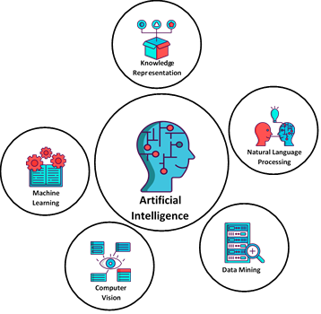
Branches of AI technologies

Slide 95
The figure: branches of AI
EXPLAINED
The icons
Centre: Artificial Intelligence: a head filled with circuit lines
Machine Learning: an open book with gears: learning as a mechanism
Knowledge Representation: a box with symbols above it: structured, stored knowledge
Natural Language Processing: a human face and a machine face exchanging an idea
Computer Vision: an eye surrounded by image panels
Data Mining: stored records under a magnifying glass
The message
AI is the umbrella; the five circles around it are major branches. All of them appear later in this module.
Figure source: diroots.com, “AI Branches” illustration.

Slide 96
Branches work together
EXPLAINED
Computer vision
See lanes, signs, pedestrians
Machine learning
Predict what other road users will do
Self-driving car
Knowledge representation
Encode the traffic rules
Data mining & NLP
Learn from fleet data; understand voice commands
Real systems combine branches. This module touches all five.

Slide 97
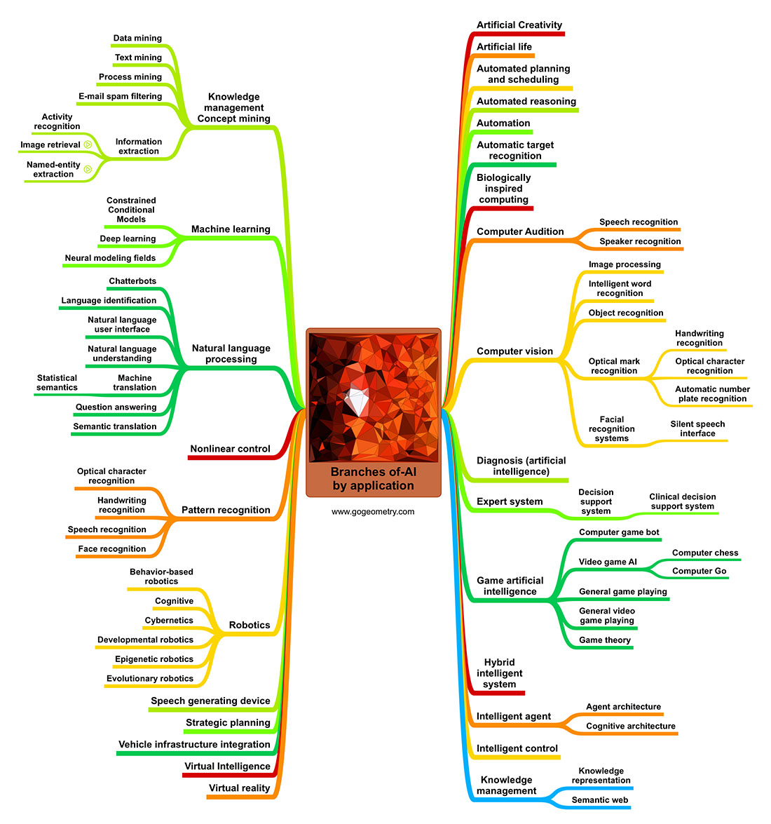
Branches of AI technologies by application

Slide 98
The figure: AI by application
EXPLAINED
How to read the mind map
The centre reads “Branches of AI by application”; each coloured line is a branch, with applications at its tips.
Red frames on the original slide highlight two clusters covered in this module.
Left cluster (framed)
Data and text mining, information extraction, machine learning (deep learning, clustering), natural language processing
Right cluster (framed)
Computer vision (face and handwriting recognition), expert systems; also game AI, intelligent agents, planning
AI is a family of techniques, each suited to different problems: choosing among them is learning outcome MLO3.

Slide 99
Intelligent level
Logic and inference
Feature learning
e.g. Deep Neural Networks
Reinforcement learning
Probability
e.g. Markov Chain
Bayesian networks
Data reflection
e.g. Decision Tree
Low-level intelligence
High-level intelligence
Explainable
Controllable
Unknown
Self-explainable
demo

Slide 100
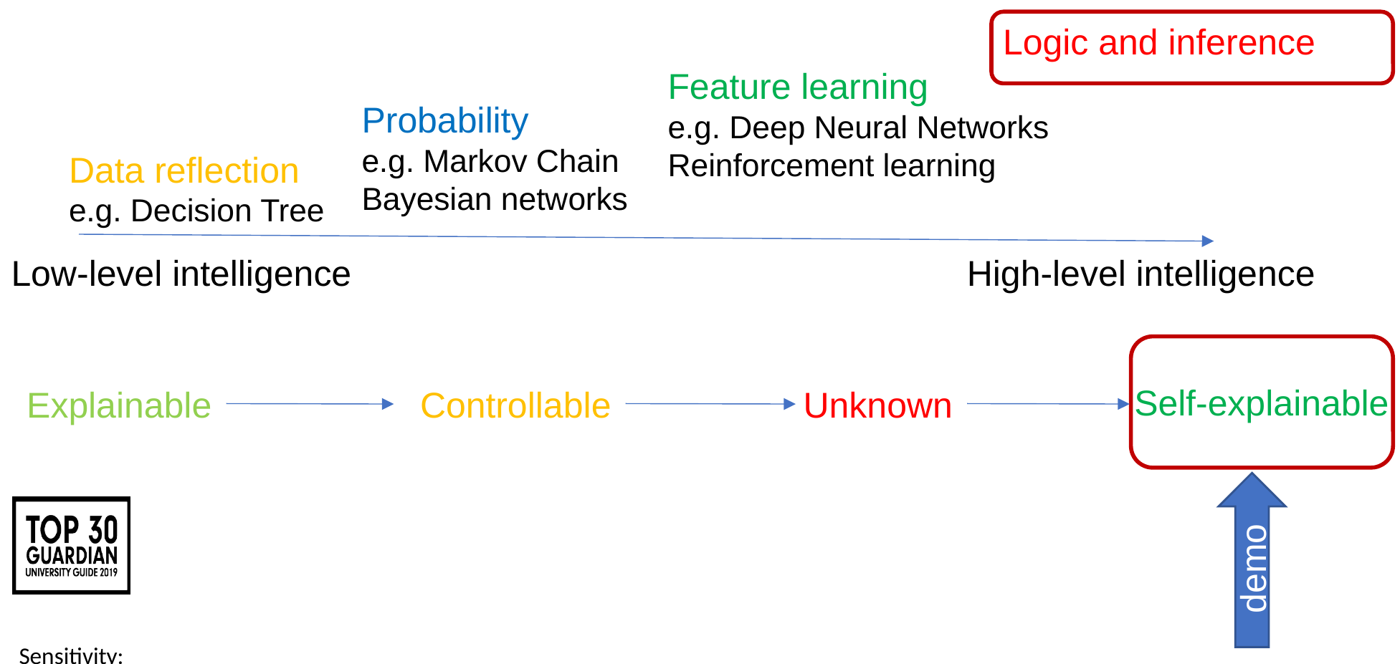
The diagram: levels of intelligence
EXPLAINED
Top arrow: level of intelligence
Data reflection, e.g. a decision tree
Probability, e.g. Markov chains, Bayesian networks
Feature learning, e.g. deep neural networks, reinforcement learning
Logic and inference (highest)
Bottom arrow: explainability
Explainable → Controllable → Unknown (“black box”) → Self-explainable
Each label sits below the level above it: decision trees are explainable, probabilistic models controllable, deep learning largely unknown.
Red frames mark the highest level on each arrow: logic and inference, and self-explainable systems.
The “demo” arrow refers to a chatbot demonstration (next slide).
Diagram from the original lecture slide. Note: higher-level intelligence tends to be harder to explain.

Slide 101
Demo: can AI explain itself?
EXPLAINED
Try it yourself
1. Give a chatbot the customer table from the data mining example
2. Ask: “Find a simple rule that predicts Buy widget, and explain your reasoning”
3. Compare with the decision tree
Decision tree: Explainable: read it as rules
Probabilistic models: Controllable: inspect and adjust
Deep learning: Black box → Explainable AI (XAI)
The goal: Self-explainable
CAUTION A chatbot’s explanation may not reflect how it actually reached its answer. Treat it as a hypothesis, and verify it.
KEY POINT Higher-level intelligence tends to be harder to explain, and explainability matters in real decisions.
Sources: Turpin et al. (2023).

Slide 102
Check your understanding
QUESTION
UNDERSTANDING
Question 12 of 15
Why is a deep neural network often called a “black box”?
BEFORE YOU MOVE ON Write or say your answer first. The model answer is on the next slide.

Slide 103
Check your understanding: answer
ANSWER
Q12 (Understanding): Why is a deep neural network often called a “black box”?
Model answer
Its knowledge is spread across millions or billions of learned parameters, so it is hard to say why it produced a particular output. It can be very accurate yet hard to explain, which is why Explainable AI (XAI) exists.
SEE Slides: The diagram: levels of intelligence

Slide 104
Check your understanding
QUESTION
APPLICATION
Question 13 of 15
A bank must explain to customers why a loan was refused. Which kind of model from the diagram would you prefer, and why?
BEFORE YOU MOVE ON Write or say your answer first. The model answer is on the next slide.

Slide 105
Check your understanding: answer
ANSWER
Q13 (Application): A bank must explain to customers why a loan was refused. Which kind of model from the diagram would you prefer, and why?
Model answer
An explainable model such as a decision tree, because its decision can be read as a set of rules and shown to the customer. This may cost some accuracy compared with deep learning: a trade-off you must justify (MLO3).
SEE Slides: The diagram: levels of intelligence; Demo: can AI explain itself?

Slide 106
Module topics (Teaching Weeks)
Weeks | Theory | Practical
1 | AI history, branches, application scenarios and relations to Data Mining and Machine Learning | Python basics
2 | Data Pre-processing and EDA | Python - Data Pre-processing
3 | Mining Frequent Pattern and Association Rules | Python - EDA
4 | Classification and Decision Tree | Python - ARL
5 | Random Forest and KNN | Python - DT
7 | Linear Regression & Logistic Regression | Python - KNN
8 | Cluster Analysis with Unsupervised Learning | Python - LR
9 | Artificial Neural Network & Deep Learning | Python - K-Means
10 | Natural Language Processing (NLP) | Python - ANN and DL
11 | Reinforcement Learning & Naïve Bayes | Python - NLP
12 | Knowledge presentation and reasoning | Python - RL and NB
13 | Review
14 -15 | Assessment period
16-18 | Enrichment period: Offsite Activities (Career support, CV support) and assessment feedback
A1 Deadline
Week 14
A2 Deadline

Slide 107
Why the plan appears again
EXPLAINED
The weekly plan is shown again so that the topics can be linked to the history and branches of AI covered in this lecture.
Weeks | Topics | Link to this lecture
Weeks 2-8 | Data mining and machine learning: data preparation, patterns, classification, regression, clustering | The 1990s shift to learning from data
Weeks 9-10 | Neural networks, deep learning, NLP | The engines of today’s AI boom
Week 11 | Reinforcement learning, Naive Bayes | AlphaGo; the probabilistic tradition
Week 12 | Knowledge representation and reasoning | Logic and expert systems (1956-1987)
The module moves from lower to higher levels of machine intelligence and touches every branch of AI.

Slide 108

Turing test

Slide 109
Section overview: Turing test
EXPLAINED
The icon shows a person and a robot exchanging speech bubbles: the Turing test is a text conversation in which a judge tries to tell the human from the machine.
This section covers
Turing’s 1950 “imitation game” and his prediction
How chatbots have performed, from ELIZA (1966) to large language models (2025)
Whether passing the test means a machine can think

Slide 110
Turing test
In Alan Turing's 1950 paper, Computing Machinery and Intelligence, the mathematician posed the question: "Can machines think?" But almost immediately he dismissed that question as too "meaningless" to be worthy of discussion, and swapped it for the much-more specific: "Are there imaginable digital computers which would do well in the imitation game?"
Turing's "imitation game" had three players: a man, a woman and an interrogator, who must work out which one is the woman. Turing asked: what if a machine took the man's place? Today's version: a judge decides which hidden player is the human and which is the machine.
https://chatbotsmagazine.com/how-close-are-chatbots-to-pass-turing-test-33f27b18305e
Demo https://openai.com/blog/chatgpt/
Demo https://www.pandorabots.com/mitsuku/

Slide 111
The links on the slide
EXPLAINED
The three links on the previous slide
chatbotsmagazine.com article
“How close are chatbots to pass the Turing test?”: background reading on chatbot performance in Turing-style tests.
openai.com/blog/chatgpt
OpenAI’s announcement of ChatGPT (November 2022), a large-language-model chatbot used here as a live demonstration.
pandorabots.com/mitsuku
Mitsuku, a rule-based chatbot that won the Loebner Prize five times; it has since been renamed Kuki.
WHY TWO CHATBOTS? Comparing a rule-based chatbot (Mitsuku/Kuki) with a large language model (ChatGPT) shows how much conversational ability has changed, and why the Turing test is debated again.
Web links may change over time; if a demo page is unavailable, any current chatbot can be used for the same comparison.

Slide 112
The Turing test: then and now
EXPLAINED
Then: Turing, 1950
Original game: an interrogator must tell the man from the woman; then a machine takes the man’s place
Prediction: by ~2000, an average interrogator would be right no more than 70% of the time after 5 minutes
Now
1966: ELIZA
1991-2019: Loebner Prize; Mitsuku (Kuki) won 5 times, no convincing pass
2025: Jones & Bergen (UC San Diego): GPT-4.5 judged human 73% of the time; ELIZA 23%
TRY IT Ask a chatbot a question that might expose a machine (a personal memory, a joke, a trick question) and judge its answer.
BUT Does passing mean thinking? Searle’s “Chinese Room” (1980): symbol manipulation ≠ understanding.
Sources: Turing (1950); Weizenbaum (1966); Searle (1980); Jones and Bergen (2025).

Slide 113
Check your understanding
QUESTION
RECALL
Question 14 of 15
What did Turing replace the question “Can machines think?” with, and what did he predict?
BEFORE YOU MOVE ON Write or say your answer first. The model answer is on the next slide.

Slide 114
Check your understanding: answer
ANSWER
Q14 (Recall): What did Turing replace the question “Can machines think?” with, and what did he predict?
Model answer
The imitation game: can a machine converse so well that an interrogator cannot tell it from a human? He predicted that within about 50 years an average interrogator would be right no more than 70% of the time after five minutes.
SEE Slides: The Turing test: then and now

Slide 115
Check your understanding
QUESTION
UNDERSTANDING
Question 15 of 15
Does passing the Turing test prove that a machine understands? Use Searle’s argument.
BEFORE YOU MOVE ON Write or say your answer first. The model answer is on the next slide.

Slide 116
Check your understanding: answer
ANSWER
Q15 (Understanding): Does passing the Turing test prove that a machine understands? Use Searle’s argument.
Model answer
Not necessarily. Searle’s Chinese Room (1980) argues that a system can manipulate symbols perfectly without understanding them: imitating intelligent behaviour is not the same as having a mind. This is the strong vs weak AI debate.
SEE Slides: The Turing test: then and now; Strong vs weak AI

Slide 117
Summary
In this lecture, you will take away the following:
  Very basic concepts of Data Mining and AI.
  The birth of AI and its development history
  Different areas of AI
  The contents and assessment of the module
Next week
Lecture: Data processing and EDA
Practice: Python for dealing with missing data and EDA diagrams

Slide 118
Practice, home work and further reading
Complete the first Python practice on Kaggle or Colab.
Try to understand the terms of Strong AI and Weak AI by reading these two articles (You need to answer a question in the discussion board):
http://ceur-ws.org/Vol-2287/paper34.pdf
https://e3zine.com/strong-artificial-intelligence/

Slide 119
Strong vs weak AI
EXPLAINED
Weak AI (Searle, 1980)
Computers as tools to study or simulate the mind.
Strong AI (Searle, 1980)
A suitably programmed computer would actually have a mind.
Reading guide
Article 1, Flowers, “Strong and Weak AI: Deweyan Considerations”: philosophical; starts from Searle; consciousness and experience.
Article 2, E-3 Magazine: practical industry view; weak AI = Siri/Alexa following programmed patterns, strong AI = systems that learn and adapt on their own.
TIP The two articles use the terms differently. Notice the difference and take a position. Where would you place ChatGPT, and why?
Sources: Searle (1980); Flowers (2019); E-3 Magazine (n.d.).

Slide 120
References (1/4)
REFERENCES
Brooks, R.A. (1990) ‘Elephants don’t play chess’, Robotics and Autonomous Systems, 6(1-2), pp. 3-15.
Campbell, M., Hoane, A.J. and Hsu, F.-h. (2002) ‘Deep Blue’, Artificial Intelligence, 134(1-2), pp. 57-83.
Darrach, B. (1970) ‘Meet Shaky, the first electronic person’, Life, 20 November, pp. 58-68.
E-3 Magazine (n.d.) Strong vs. weak artificial intelligence. Available at: https://e3zine.com/strong-artificial-intelligence/
Fayyad, U., Piatetsky-Shapiro, G. and Smyth, P. (1996) ‘From data mining to knowledge discovery in databases’, AI Magazine, 17(3), pp. 37-54.
Flowers, J.C. (2019) ‘Strong and weak AI: Deweyan considerations’, CEUR Workshop Proceedings, 2287. Available at: http://ceur-ws.org/Vol-2287/paper34.pdf
Han, J. and Kamber, M. (2006) Data Mining: Concepts and Techniques. 2nd edn. San Francisco: Morgan Kaufmann.
Han, J., Kamber, M. and Pei, J. (2011) Data Mining: Concepts and Techniques. 3rd edn. Waltham, MA: Morgan Kaufmann.
Investopedia (n.d.) Artificial intelligence (AI). Available at: https://www.investopedia.com
Jones, C.R. and Bergen, B.K. (2025) ‘Large language models pass the Turing test’, arXiv preprint, arXiv:2503.23674.

Slide 121
References (2/4)
REFERENCES
Karp, R.M. (1972) ‘Reducibility among combinatorial problems’, in Miller, R.E. and Thatcher, J.W. (eds) Complexity of Computer Computations. New York: Plenum, pp. 85-103.
Krizhevsky, A., Sutskever, I. and Hinton, G.E. (2012) ‘ImageNet classification with deep convolutional neural networks’, Advances in Neural Information Processing Systems, 25, pp. 1097-1105.
LeCun, Y. et al. (1989) ‘Backpropagation applied to handwritten zip code recognition’, Neural Computation, 1(4), pp. 541-551.
Lighthill, J. (1973) ‘Artificial intelligence: a general survey’, in Artificial Intelligence: A Paper Symposium. London: Science Research Council.
McCarthy, J. and Hayes, P.J. (1969) ‘Some philosophical problems from the standpoint of artificial intelligence’, Machine Intelligence, 4, pp. 463-502.
McCarthy, J., Minsky, M.L., Rochester, N. and Shannon, C.E. (1955) A proposal for the Dartmouth summer research project on artificial intelligence. Reprinted in AI Magazine (2006), 27(4), pp. 12-14.
McDermott, J. (1982) ‘R1: a rule-based configurer of computer systems’, Artificial Intelligence, 19(1), pp. 39-88.
Minsky, M. and Papert, S. (1969) Perceptrons: An Introduction to Computational Geometry. Cambridge, MA: MIT Press.
Mitchell, T.M. (1997) Machine Learning. New York: McGraw-Hill.
Newell, A. and Simon, H.A. (1956) ‘The logic theory machine’, IRE Transactions on Information Theory, 2(3), pp. 61-79.

Slide 122
References (3/4)
REFERENCES
Newell, A., Shaw, J.C. and Simon, H.A. (1959) ‘Report on a general problem-solving program’, Proceedings of the International Conference on Information Processing. Paris: UNESCO, pp. 256-264.
NobelPrize.org (2024a) The Nobel Prize in Physics 2024. Available at: https://www.nobelprize.org
NobelPrize.org (2024b) The Nobel Prize in Chemistry 2024. Available at: https://www.nobelprize.org
O’Neil, C. and Schutt, R. (2013) Doing Data Science. Sebastopol, CA: O’Reilly Media.
OpenAI (2022) Introducing ChatGPT. Available at: https://openai.com/blog/chatgpt
Pearl, J. (1988) Probabilistic Reasoning in Intelligent Systems. San Mateo, CA: Morgan Kaufmann.
Quillian, M.R. (1968) ‘Semantic memory’, in Minsky, M. (ed.) Semantic Information Processing. Cambridge, MA: MIT Press, pp. 227-270.
Rumelhart, D.E., Hinton, G.E. and Williams, R.J. (1986) ‘Learning representations by back-propagating errors’, Nature, 323, pp. 533-536.
Russell, S. and Norvig, P. (2003) Artificial Intelligence: A Modern Approach. 2nd edn. Upper Saddle River, NJ: Prentice Hall.
Russell, S. and Norvig, P. (2020) Artificial Intelligence: A Modern Approach. 4th edn. Hoboken, NJ: Pearson.

Slide 123
References (4/4)
REFERENCES
Samuel, A.L. (1959) ‘Some studies in machine learning using the game of checkers’, IBM Journal of Research and Development, 3(3), pp. 210-229.
Searle, J.R. (1980) ‘Minds, brains, and programs’, Behavioral and Brain Sciences, 3(3), pp. 417-424.
Shannon, C.E. (1950) ‘Programming a computer for playing chess’, Philosophical Magazine, 41(314), pp. 256-275.
Silver, D. et al. (2016) ‘Mastering the game of Go with deep neural networks and tree search’, Nature, 529, pp. 484-489.
Simon, H.A. (1965) The Shape of Automation for Men and Management. New York: Harper & Row.
Turing, A.M. (1950) ‘Computing machinery and intelligence’, Mind, 59(236), pp. 433-460.
Turpin, M., Michael, J., Perez, E. and Bowman, S.R. (2023) ‘Language models don’t always say what they think: unfaithful explanations in chain-of-thought prompting’, Advances in Neural Information Processing Systems, 36.
Vaswani, A. et al. (2017) ‘Attention is all you need’, Advances in Neural Information Processing Systems, 30.
Weizenbaum, J. (1966) ‘ELIZA: a computer program for the study of natural language communication between man and machine’, Communications of the ACM, 9(1), pp. 36-45.
Zadeh, L.A. (1965) ‘Fuzzy sets’, Information and Control, 8(3), pp. 338-353.

